Slide 1
Classroom Management Tips
By: Kylee Reuther and McKayla Roll

Slide 2
Table of Contents
Primary Grades = Background Maroon
Secondary Grades = Background Dark Purple
Primary and Secondary Grades = Background Dark Green
Starlab Experience

Slide 3
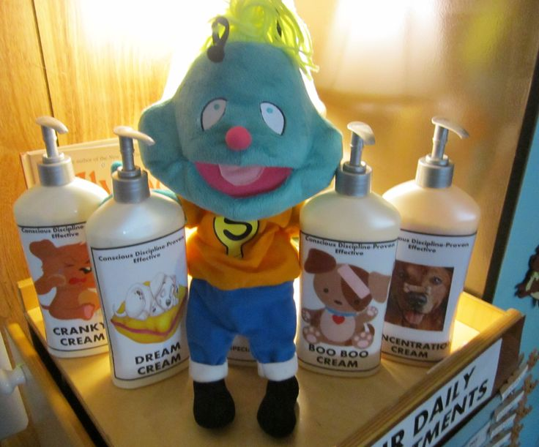
Lotion Regulation

Slide 4
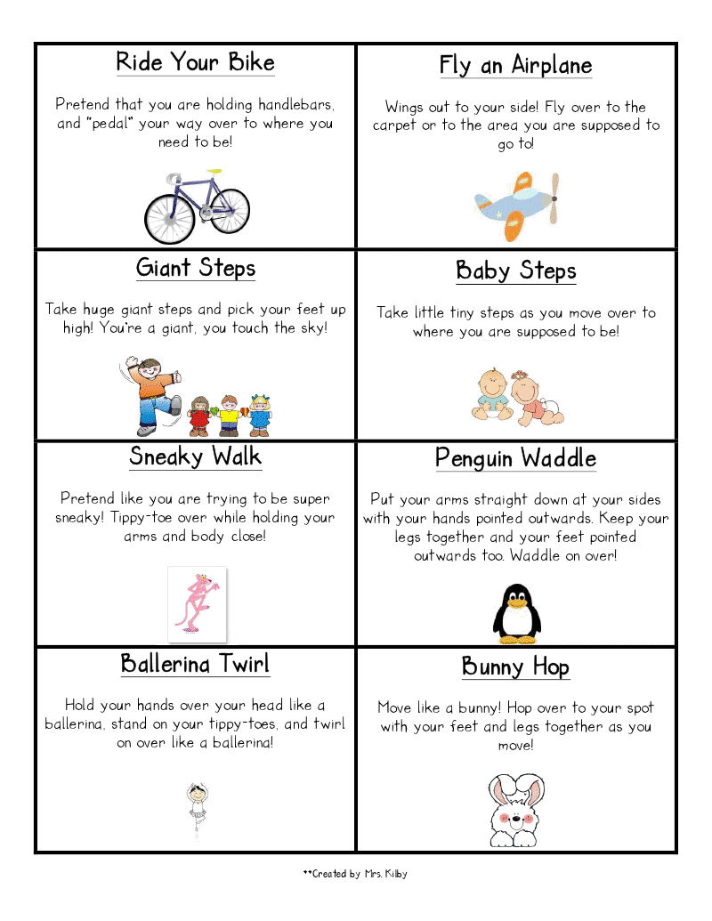
Transition Cards

Slide 5
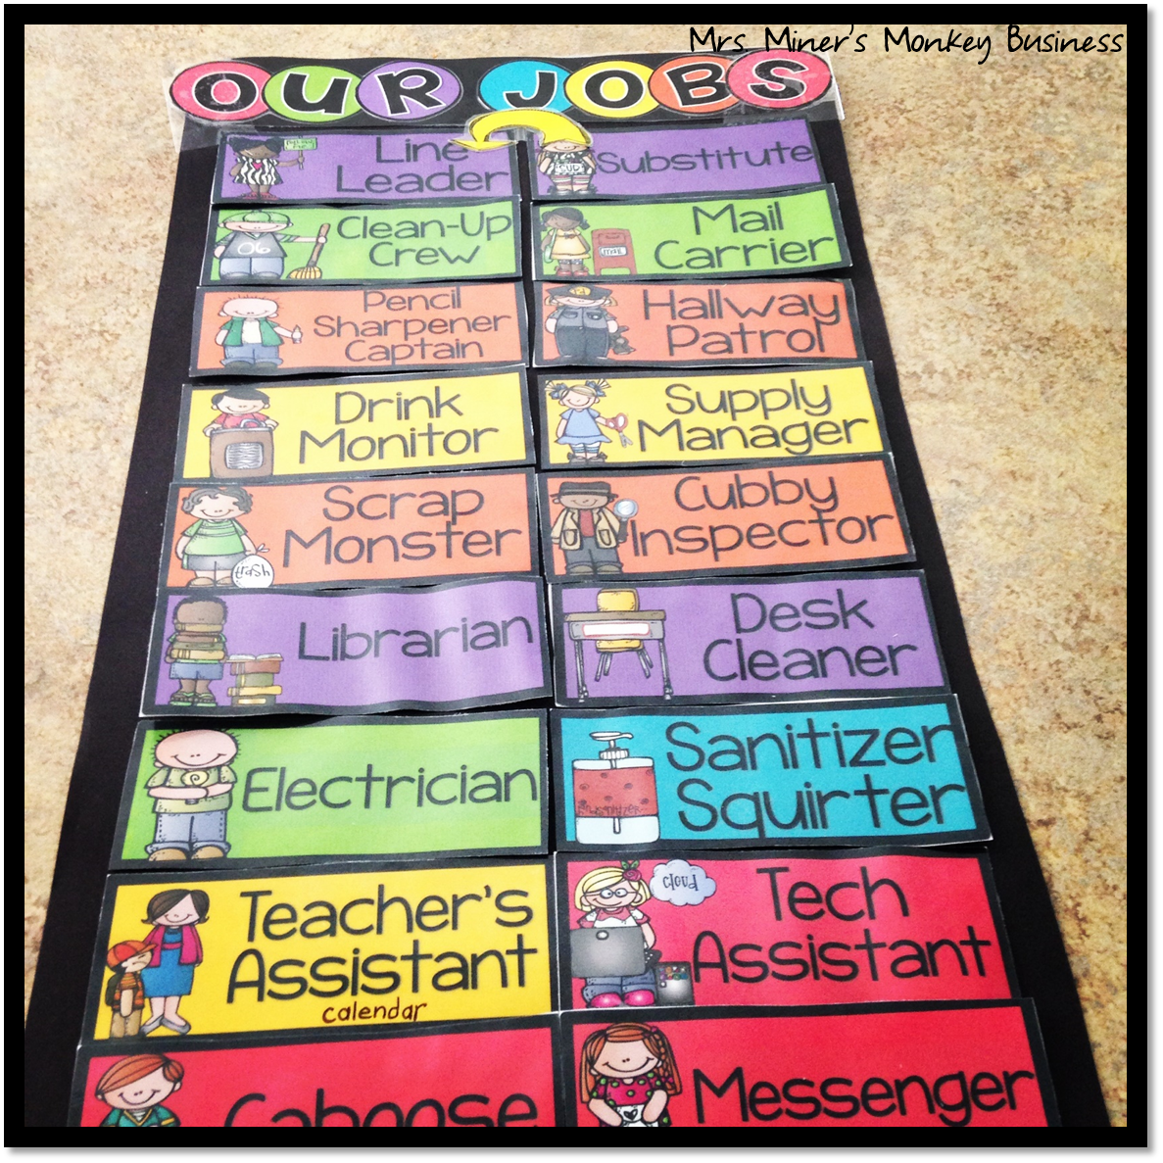
Classroom Jobs

Slide 6
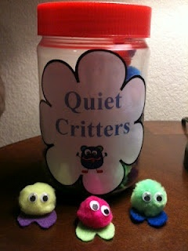
Quiet Critters

Slide 7
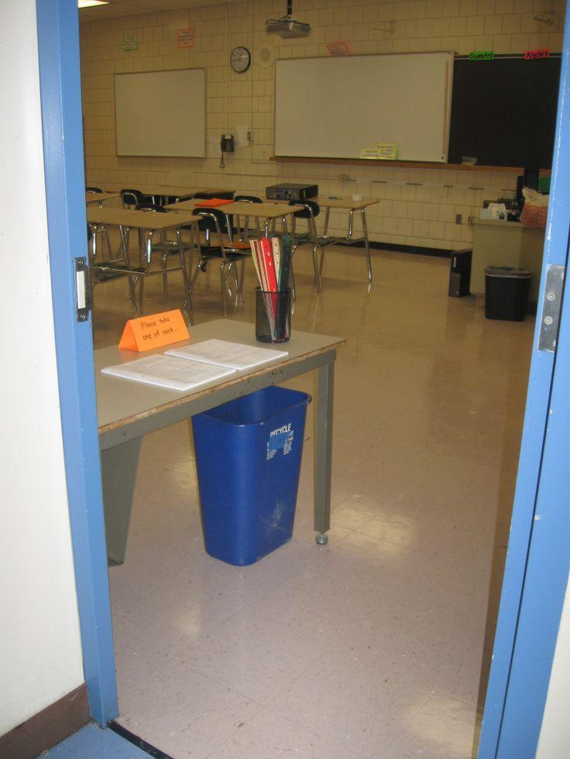
Entrance Desk
Teacher has supplies that students need for that hour at the entrance of the door.

Slide 8
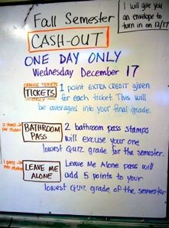
Cash Out
Tickets earned for:
participation, critical thinking, vocabulary usage, weekly attendance, etc.
Tickets used for:
pens, pencils, tissue, bathroom privileges, test questions, and candy
3x5 Bathroom emergency- two stamps
1 Leave me alone card
*students are responsible for it all

Slide 9
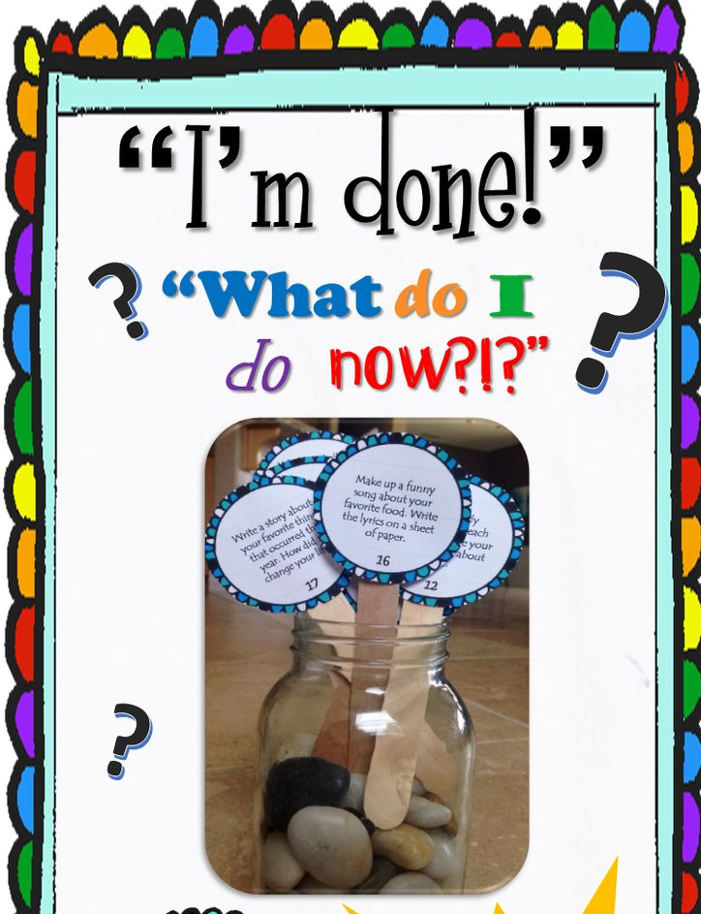
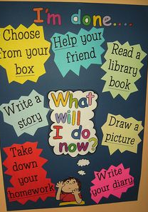
“I’m done… Now what?”

Slide 10
Techniques
“Teach like a Champion” Video
“I need three people”-private
“I don’t have Marissa, but I do have Jasmine”-not private
Hand raising signals for the class
Three fingers- bathroom
Two fingers-drink
One finger- tissue

Slide 11
https://www.youtube.com/watch?v=_NYb5rI7CFA

Slide 12
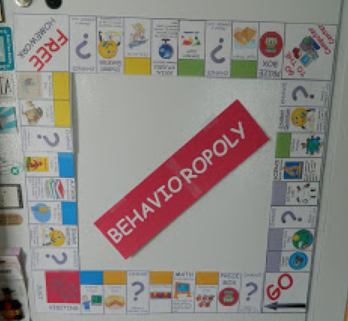
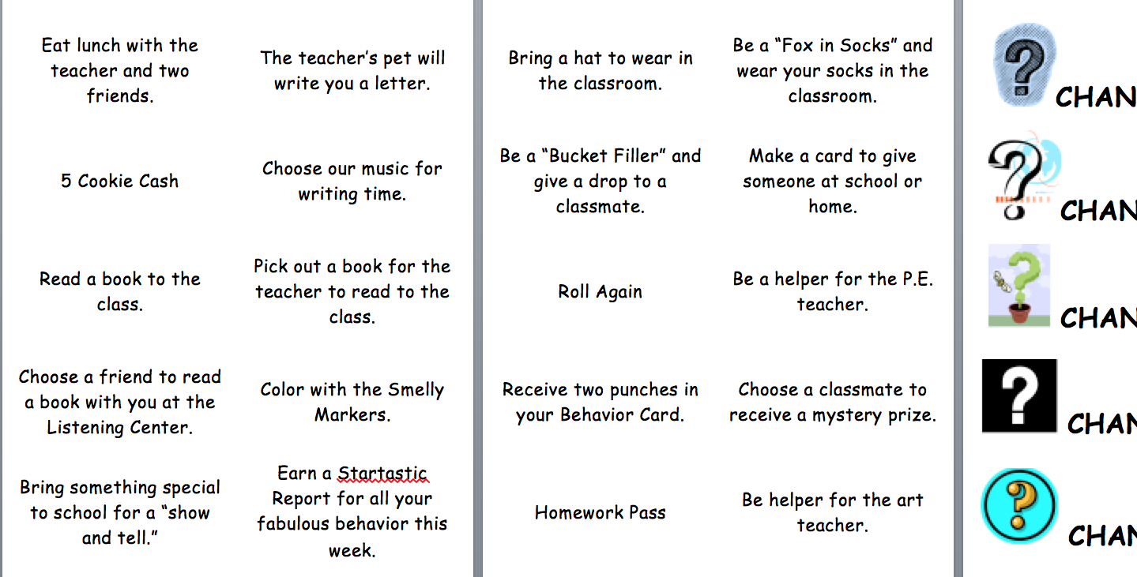
BEHAVIOROPOLY

Slide 13
Classroom Shout Outs
Teacher
Hocus Pocus
Zip it lock it
Flat tire
Shark bait
A.B.C
Holy Moly
Student
Time to focus
Put it in your pocket
Ssshhhhhh!!!!
Ooohh ha ha!
Easy as 1.2.3
Guacamole
*Golf clap*

Slide 14
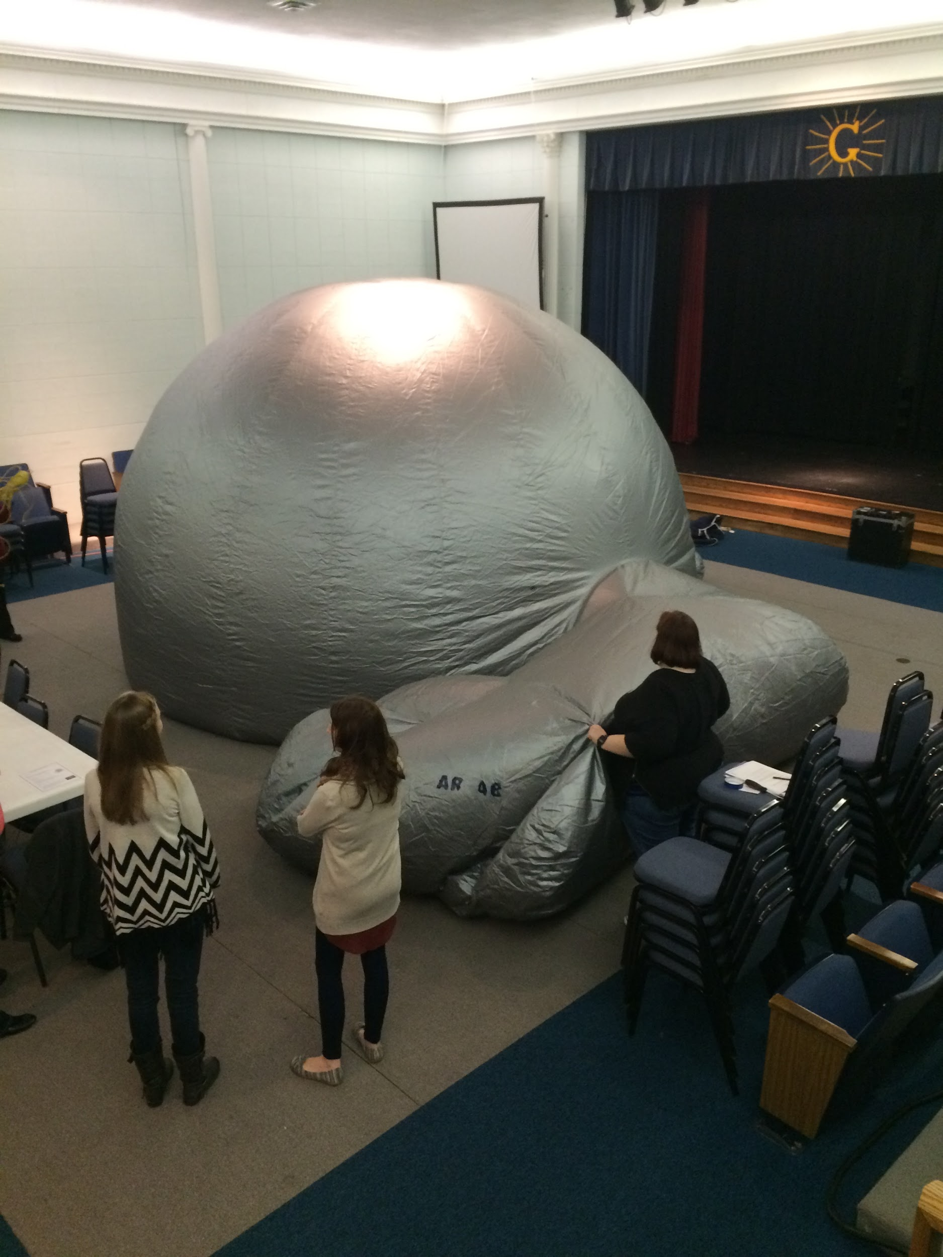
Starlab

Slide 15
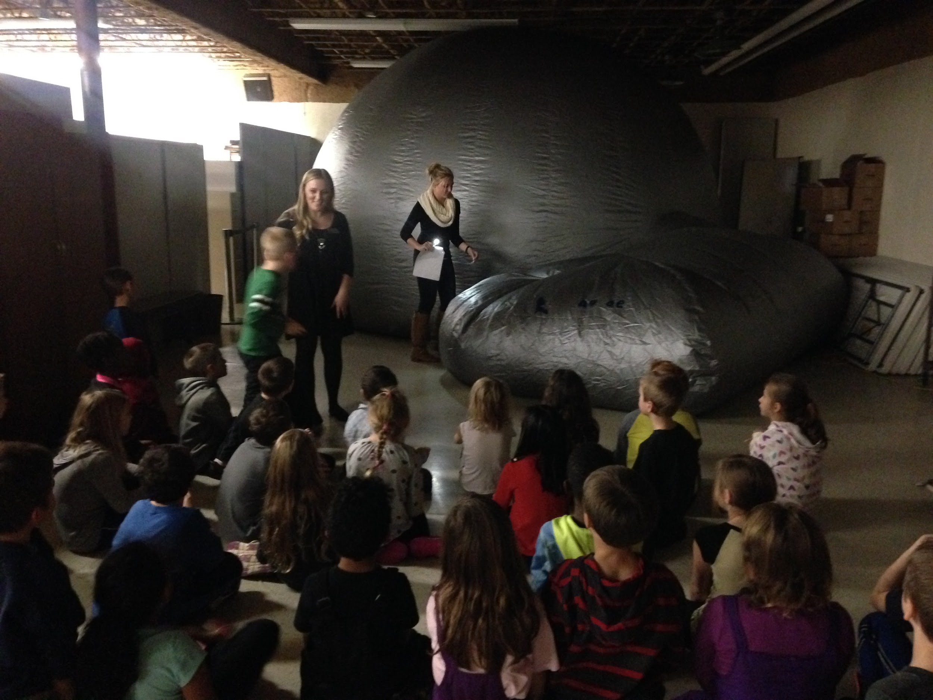

Slide 16
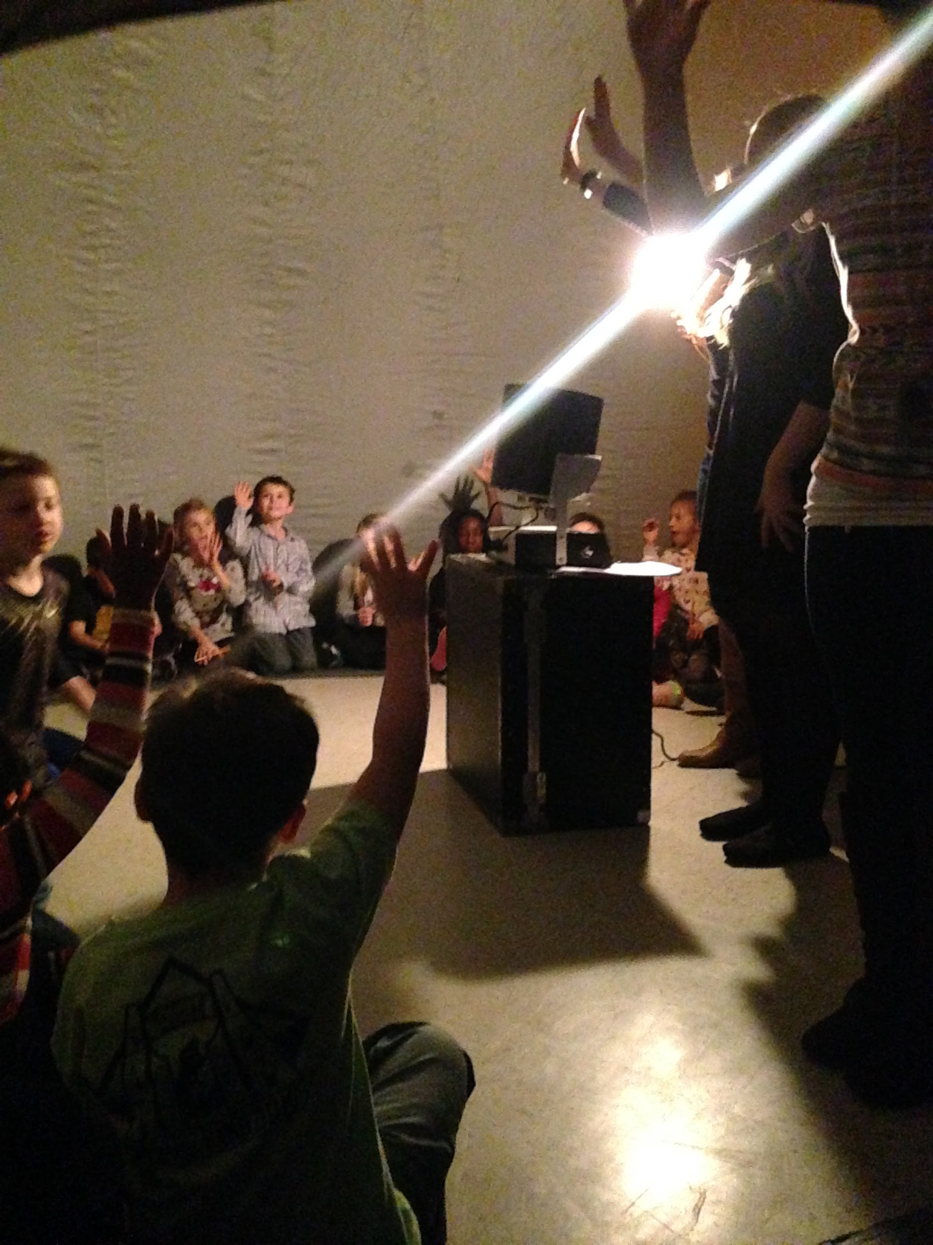
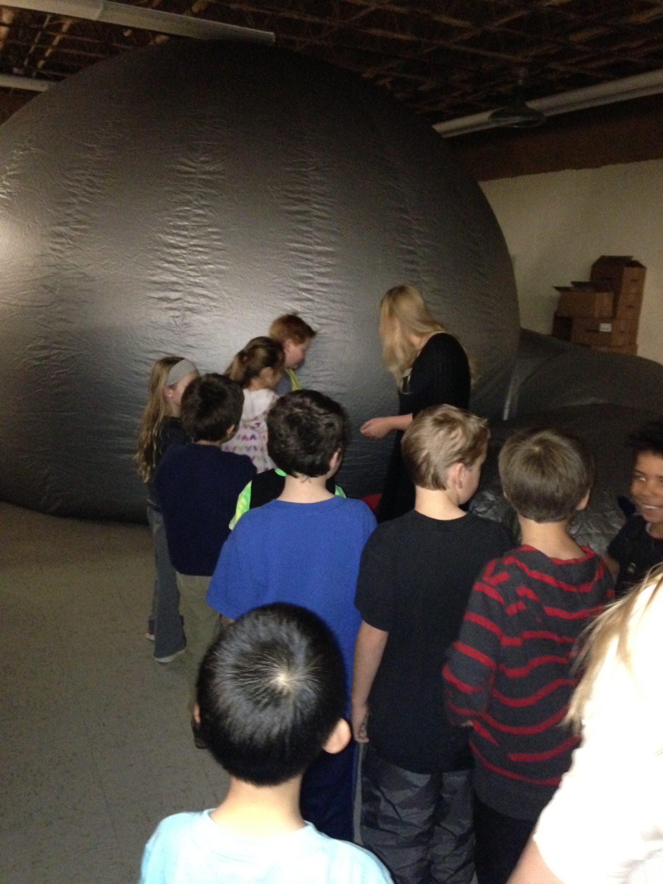

Slide 19
